Slide 1

STACK OVERFLOW DEVELOPER SURVEY

Slide 2
OUTLINE
Executive Summary
Introduction
Methodology
Results
Visualization –Charts
Dashboard
Discussion
Findings & Implications
Conclusion
Appendix

Slide 3
EXECUTIVE SUMMARY
Data contextualization and analysis goal.
Methodology description.
Data gathering.
Data analysis.
Data visualizations.
Results presentation supported with graphs and trends.
Discussion of overall findings and implications regarding the results previously exposed.
Final conclusions of the carried out research.

Slide 4
INTRODUCTION
Stack Overflow’s annual Developer Survey is the largest and most comprehensive survey of people who code around the world.
Results don’t represent everyone in the developer community evenly.
Nearly 90,000 developers.
Trends to predict where the developers are going.
Characterization of developers around the globe.

Slide 5
METHODOLOGY
Collect survey data & explore its content
Web Scraping
APIs.
Request library.
Data Wrangling
Exploratory data analysis
Analyzing data distribution.
Handling outliers.
Correlations.
Data Visualization
Highlight distribution of data, relationships, the composition and comparison of data.
Dashboards

Slide 6

RESULTS

Slide 7
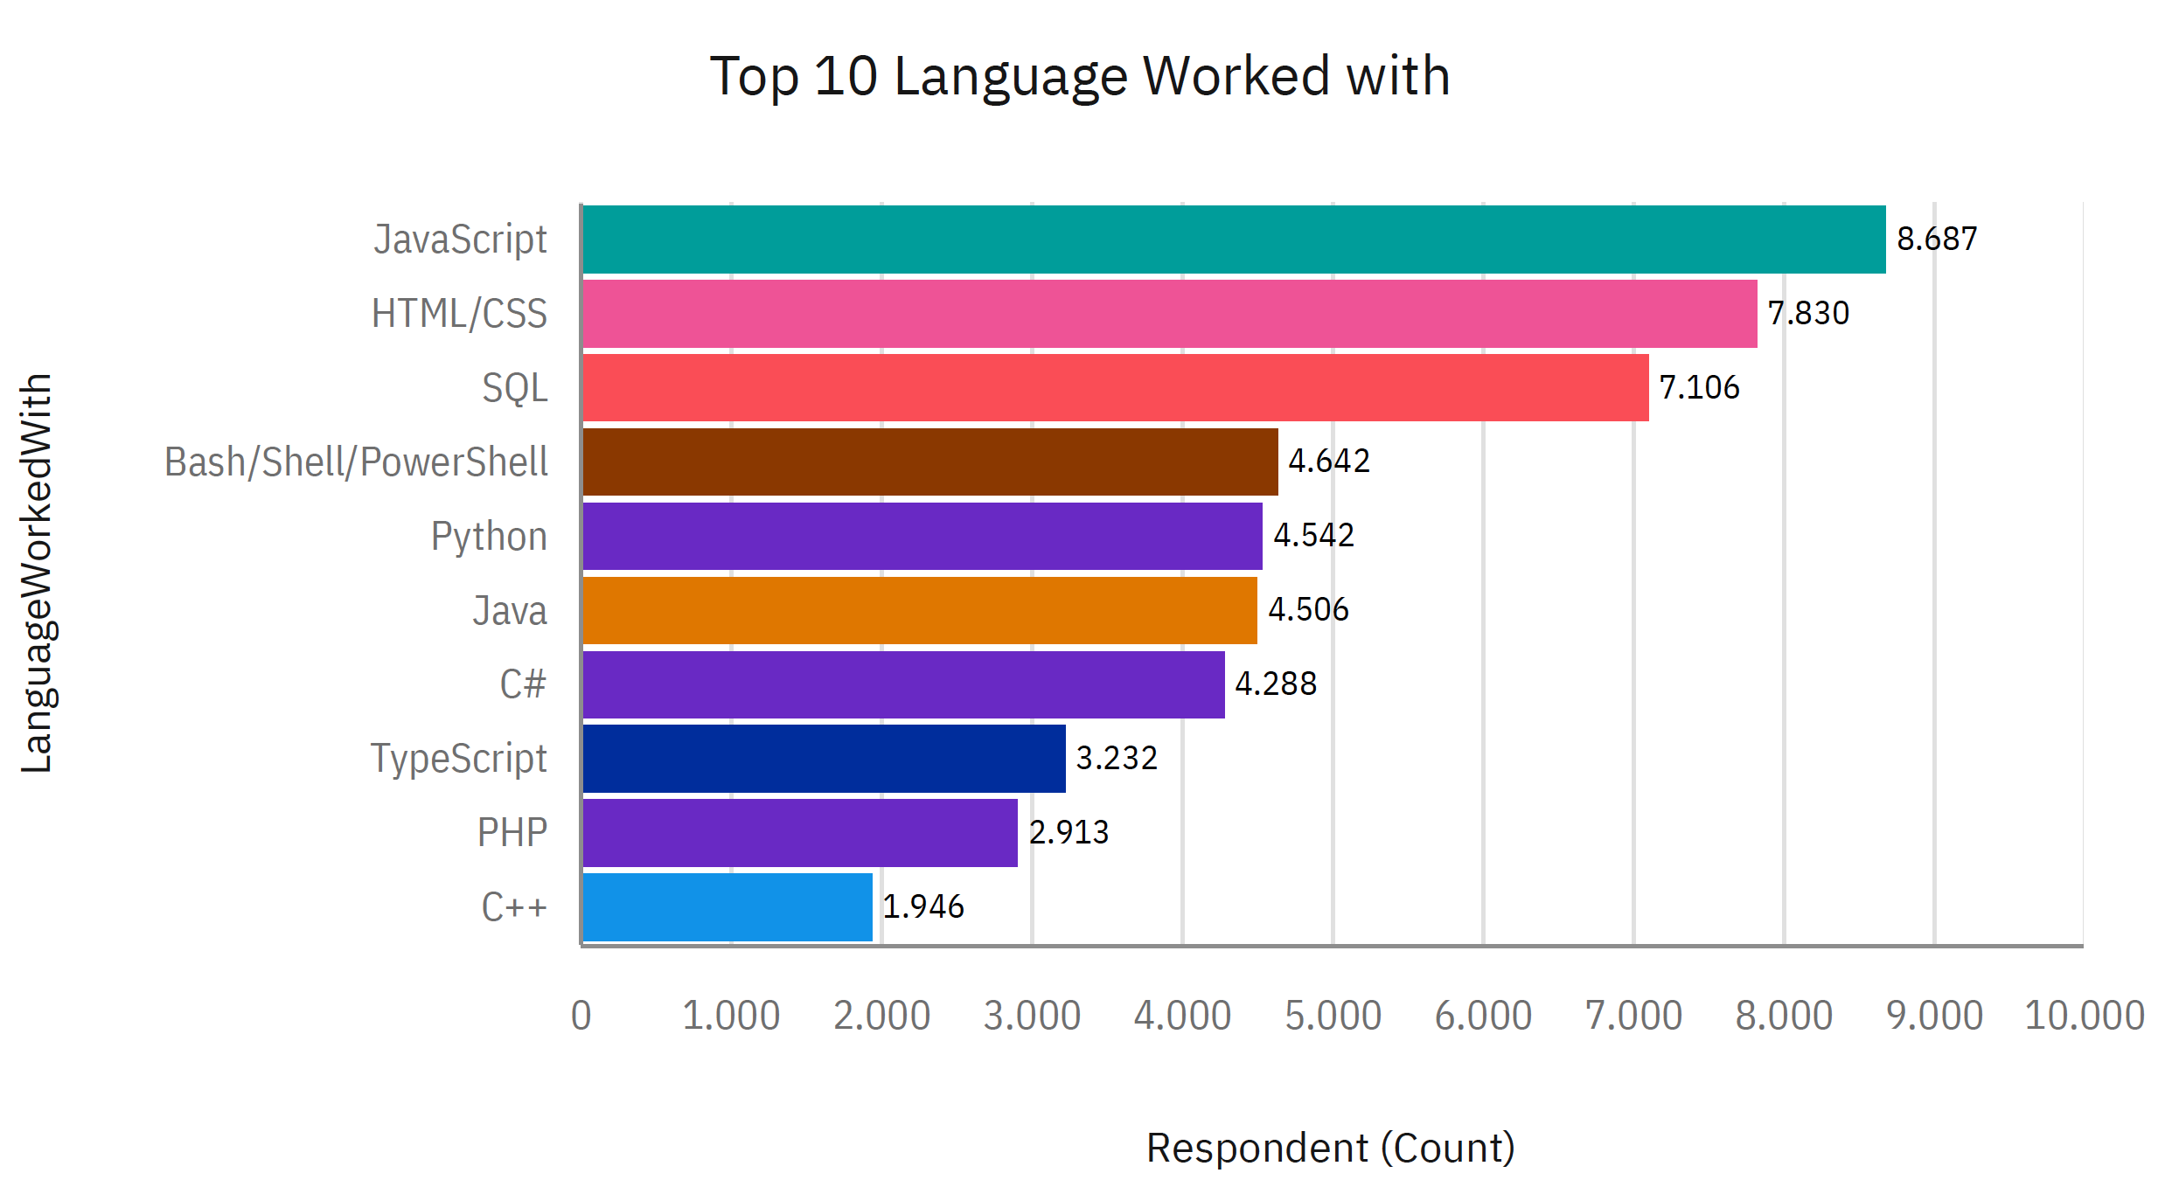
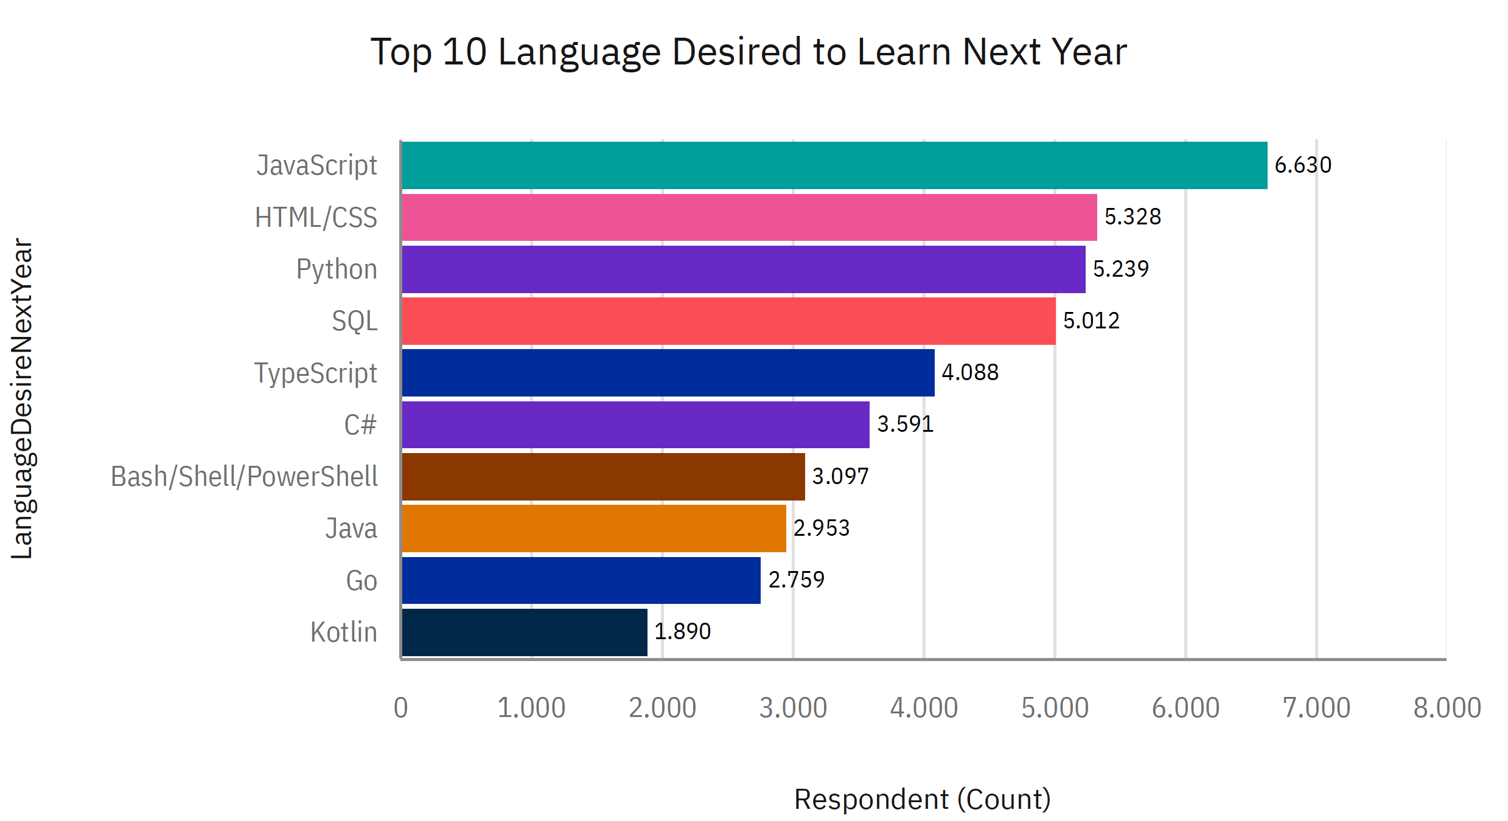
PROGRAMMING LANGUAGE TRENDS
CURRENT YEAR
NEXT YEAR

Slide 8
PROGRAMMING LANGUAGE TRENDS FINDINGS & IMPLICATION
Findings
Javascript seems to keep as leading language
Python fastest-growing
Great interest in TypeScript
Implications
Possible developers migration from JavaScript to TypeScript

Slide 9
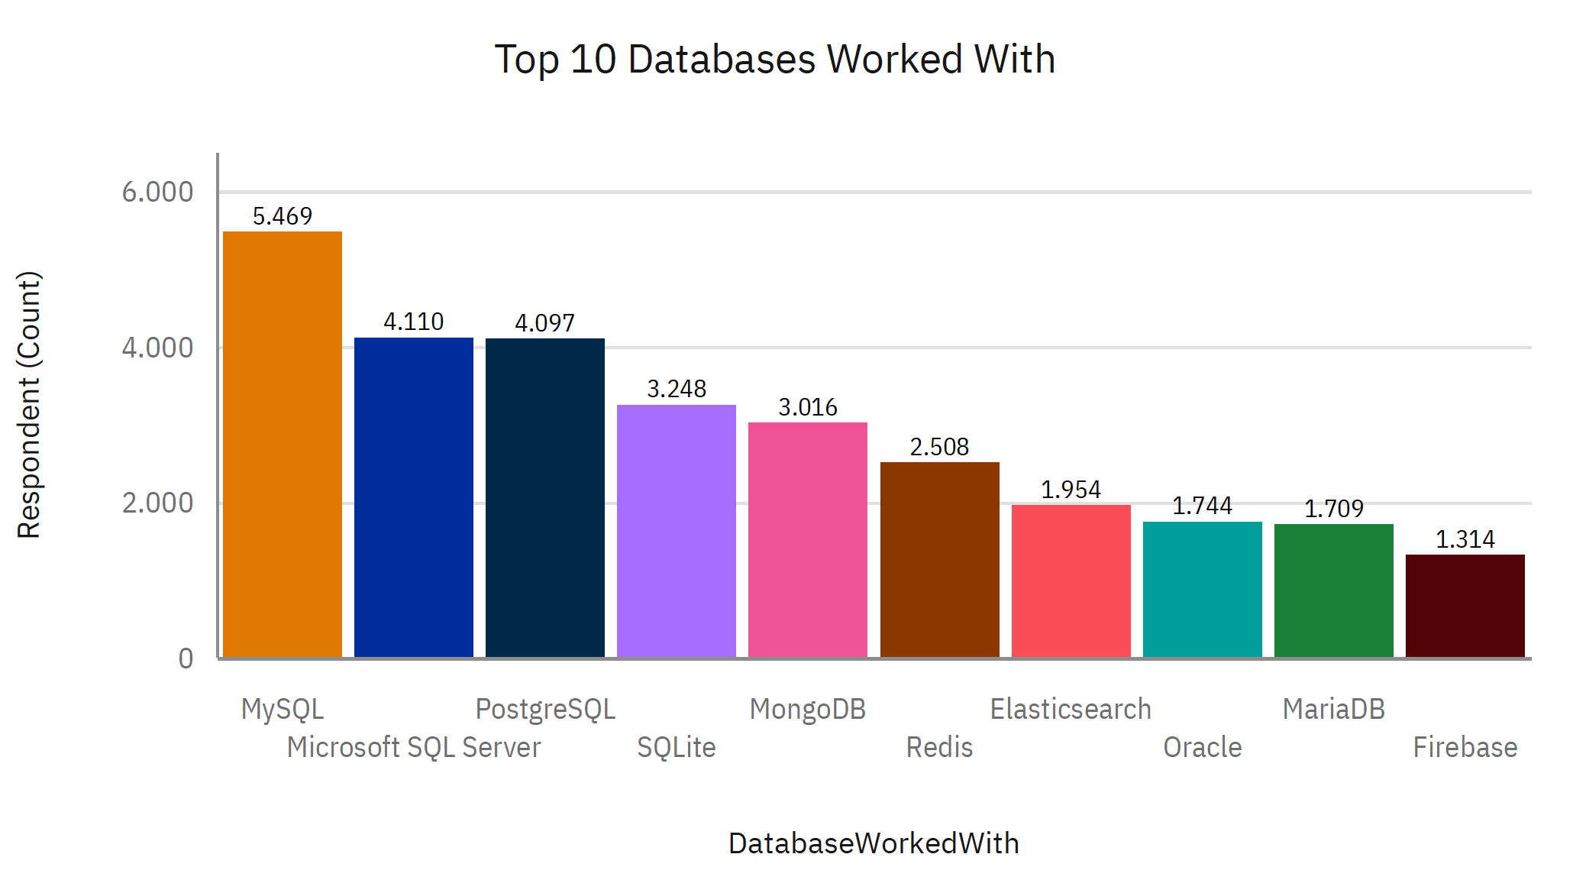
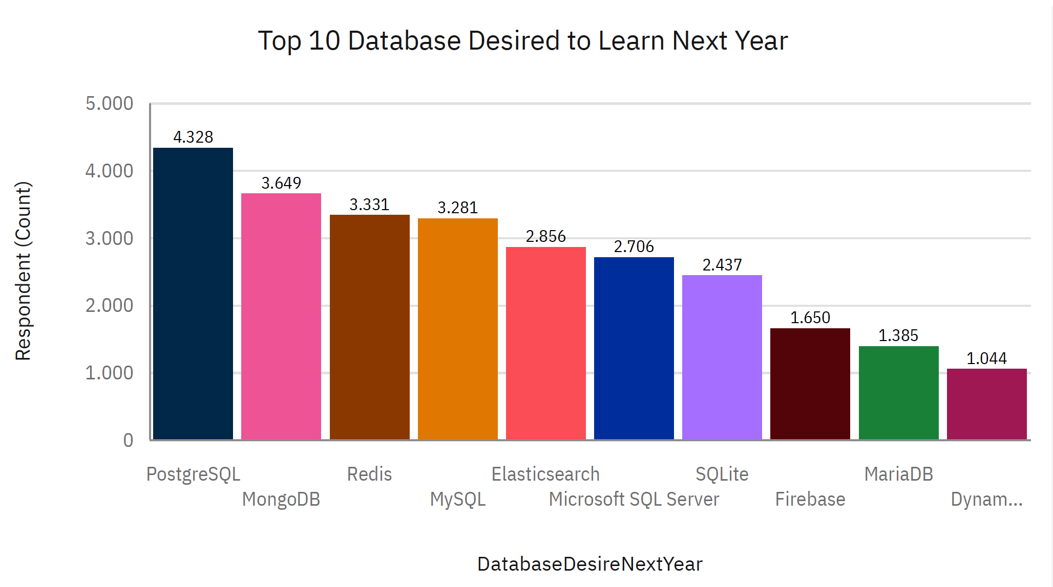
Database TRENDS
CURRENT YEAR
NEXT YEAR

Slide 10
DATABASE TRENDS - FINDINGS & IMPLICATIOn
Findings
Implications
Increasing interest in PostgreSQL and MongoDB
MySQL as most used database
Lack of interest in MSSQL and SQL lite
Microsoft SQL server and SQLite losing ground in the market
PostgreSQL and MongoDB establishment in the market

Slide 11
DASHBOARD
https://github.com/Kiet-Analytics/Dashboard_IBM_Cognos/blob/main/Dashboard_IBM_Cognos.pdf

Slide 12
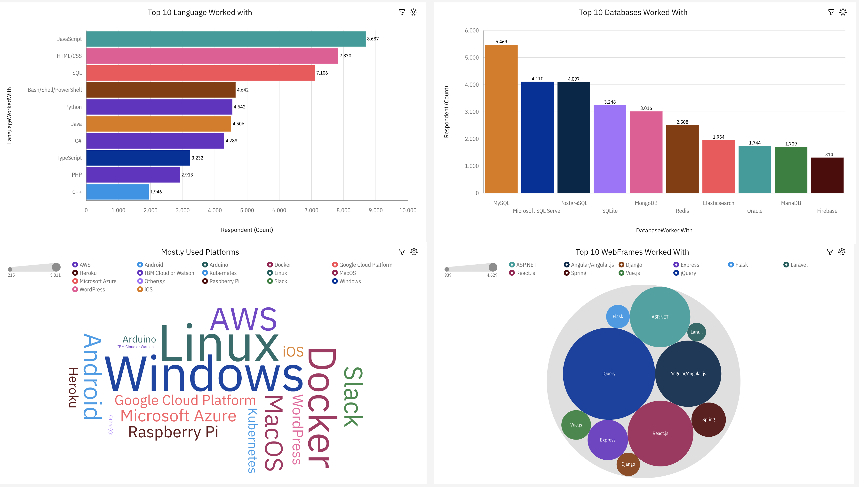
CURRENT TECHNOLOGY USAGE

Slide 13
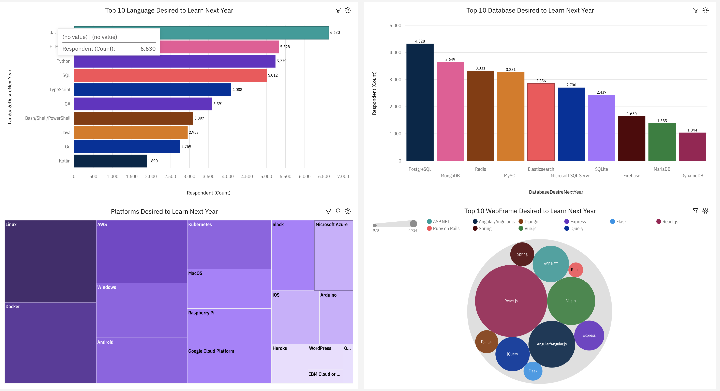
Future TECHNOLOGY USAGE

Slide 14
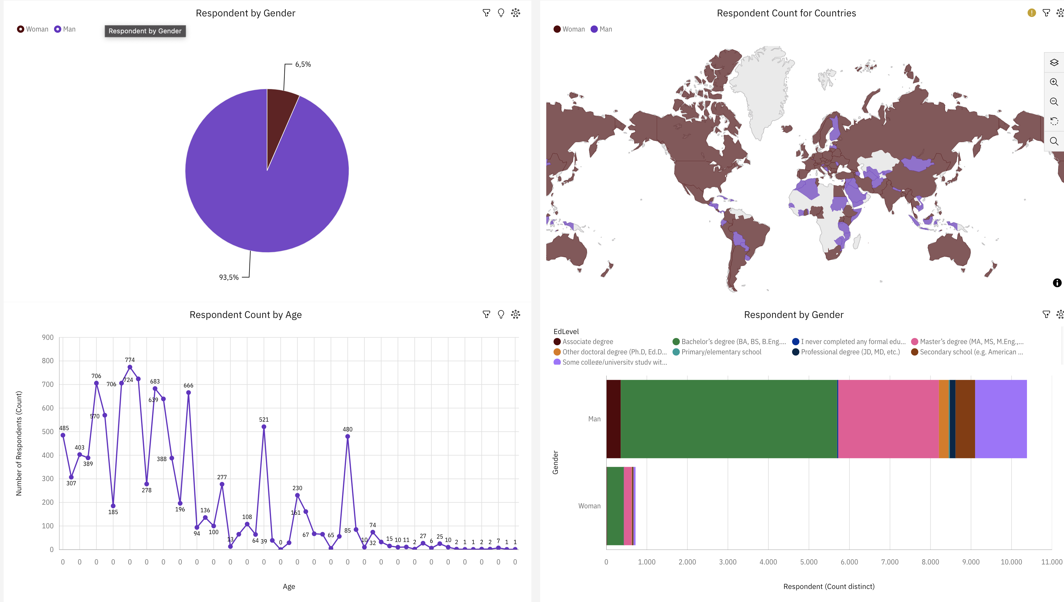
Demographics

Slide 15

DISCUSSION

Slide 16
OVERALL FINDINGS & IMPLICATIONS
Findings
JavaScript widely used and TypeScript getting popular
Over 90% young male developers
Developers mostly located in developed countries.
Implications
JavaScript and TypeScript web frames gaining followers
Global polarization of developers location and gender
Young developers without postgrad studies on its majority

Slide 17

CONCLUSION
Developers are people with very marked characteristics
A good idea of popularity trends of different tools, platforms and languages can be obtained
There is a job to be done to spread accessibility of this labor market to countries in development

